Slide 1

RentEase – Borrow Instead of Buying
Why buy when you can borrow? RentEase connects urban renters and lenders across India, making it easy to access tools, appliances, electronics, and more from your neighbourhood. Save money, reduce waste, and build trust within your local community.

Slide 2
How RentEase Works
Borrowing items locally has never been simpler. Our platform connects you with verified lenders nearby, ensuring safe, seamless transactions every time.
01
02
Sign Up & Verify
Search & Discover
Create your profile with Google or phone OTP, add your address, and build your trust score through verification.
Browse items by category, name, or distance. Use our map view to find what you need within your locality.
03
04
Request & Chat
Borrow & Return
Send a borrow request, chat with the lender to confirm details, and arrange pickup or delivery.
Enjoy your borrowed item, upload condition proof before and after use, and return it on time to earn trust points.

Slide 3

User Features – Designed for Convenience
RentEase puts powerful tools in your hands, making borrowing smooth, secure, and rewarding.
Quick Sign Up & Login
Smart Search & Filters
Register instantly using Google or phone OTP. Your profile is secure, verified, and ready in minutes.
Find exactly what you need by searching items, filtering by category, and sorting by distance from your location.
Interactive Map View
In-App Chat System
Visualise available items nearby with our intuitive map interface. See lender locations and item availability at a glance.
Message lenders directly, clarify details, negotiate pickup times, and build trust before borrowing.
Ratings & Reviews
Deposit Protection
Rate your experience and read reviews from others. Transparency builds community trust and accountability.
Pay a small refundable deposit for peace of mind. It's returned automatically once you confirm the item's safe return.

Slide 4

Lender Features – Earn While You Share
Turn Idle Items Into Income
Have tools, appliances, or electronics gathering dust? List them on RentEase and start earning. You control the pricing, availability, and who borrows from you.
Upload photos and detailed descriptions
Set daily rent or offer items for free
Specify condition and replacement cost
Approve or reject borrow requests based on trust score
Track earnings through your dashboard
Whether you want to monetise your belongings or simply help neighbours, RentEase makes lending effortless and rewarding.

Slide 5

Trust Score System – Built on Reputation
Your trust score is your digital reputation. It grows with every successful transaction, verified detail, and positive review you receive.
Successful Returns
Earn points every time you return items on time and in good condition. Consistency builds credibility.
Zero Complaints
Maintain a clean record by treating items with care and communicating clearly with lenders.
Verified Address
Complete your profile with a verified address to unlock higher trust levels and better borrowing opportunities.
Optional Aadhaar Verification
Add an extra layer of trust with Aadhaar verification, giving lenders more confidence in your identity.

Slide 6
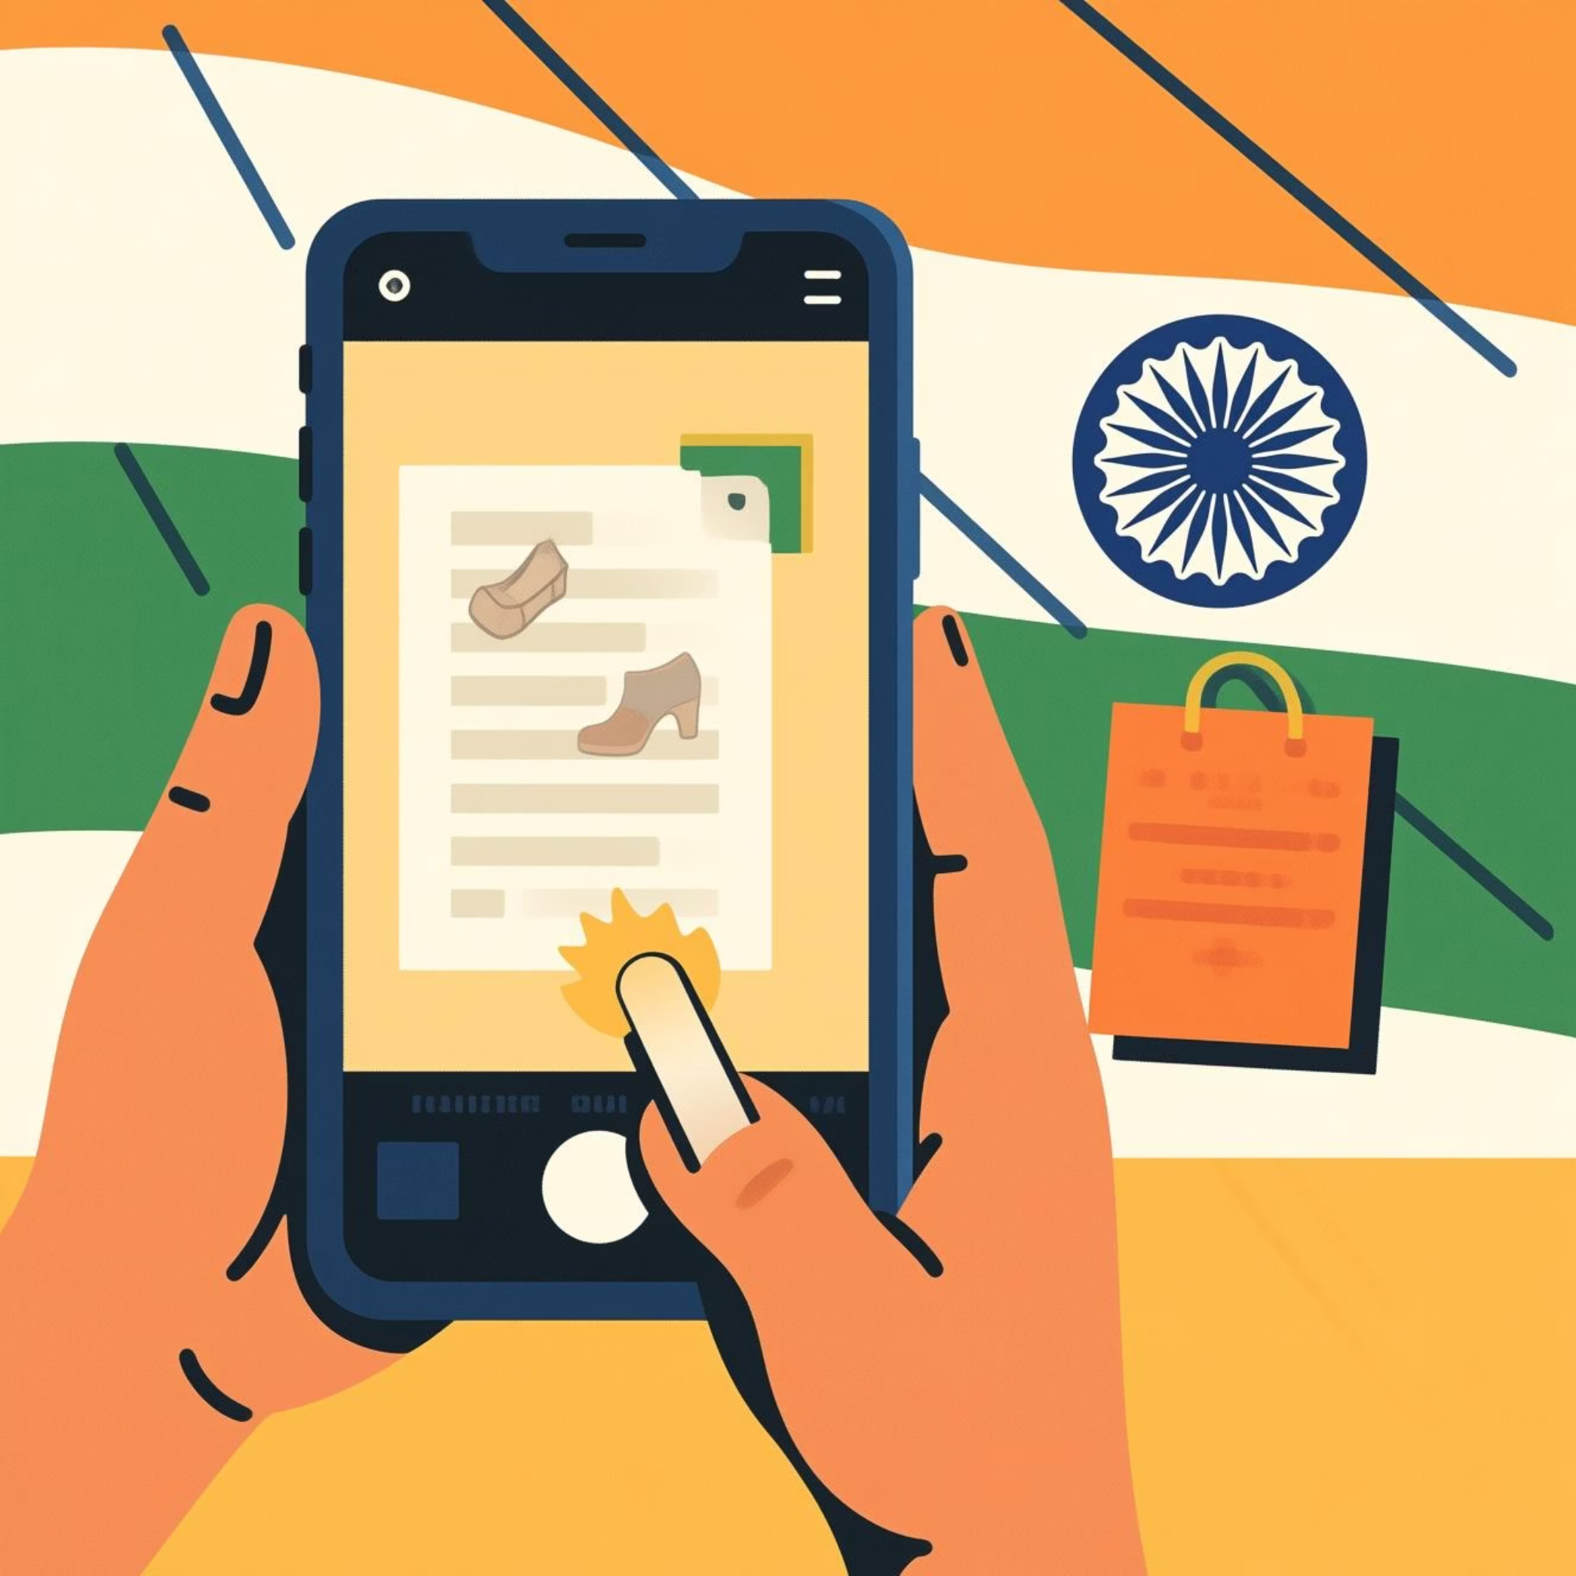
Item Condition Proof – Transparency First
Before & After Photos
Upload photos of the item's condition before borrowing and after returning. This simple step protects both borrowers and lenders, reducing disputes and building accountability.
Clear proof of item condition at handover
Evidence in case of damage or disputes
Automatic reminders to upload photos
Stored securely for future reference

Slide 7
Smart Recommendations Just for You
Discover what your neighbours are borrowing and find trending items in your area. Our recommendation engine suggests items based on local demand and your browsing history.
Most Borrowed in Your Colony
Trending Items This Week
Personalised Suggestions
See which items are popular in your neighbourhood, from power tools to party supplies, and join the sharing economy.
Stay updated on what's in demand locally. Seasonal needs, festival essentials, and community favourites surface here.
Based on your search history and preferences, we recommend items you might need, making discovery effortless.

Slide 8





Admin Dashboard – Keeping the Platform Safe
Our dedicated admin team monitors the platform 24/7, ensuring a safe, fraud-free experience for all users.
User Management
Approve new users, verify profiles, and monitor activity to maintain quality standards.
Item Verification
Review item listings to ensure accuracy, quality, and compliance with platform guidelines.
Dispute Resolution
Track and resolve conflicts quickly and fairly, protecting both borrowers and lenders.
Fraud Prevention
Identify and ban fraudulent users, keeping the community safe and trustworthy.
Analytics Dashboard
Monitor platform performance, user growth, and transaction trends through real-time data insights.

Slide 9
Why Choose RentEase?
Save Money
Reduce Waste
Build Community
Why spend thousands on items you'll only use once or twice? Borrow at a fraction of the cost and keep more cash in your pocket.
Sharing reduces consumption and environmental impact. Join a sustainable movement that benefits everyone.
Connect with neighbours, build trust, and create meaningful relationships within your local area.
5K+
15K+
98%
Active Users
Items Listed
Success Rate
Growing community across India
Tools, appliances, electronics, and more
Safe, smooth transactions every time

Slide 10



Ready to Start Borrowing?
Join thousands of Indians who are saving money, reducing waste, and building stronger communities through RentEase. Sign up today and discover a smarter way to access what you need.
Have questions? Contact our support team at support@rentease.in or call us at 1800-RENTEASE. We're here to help you get started.

